Slide 1
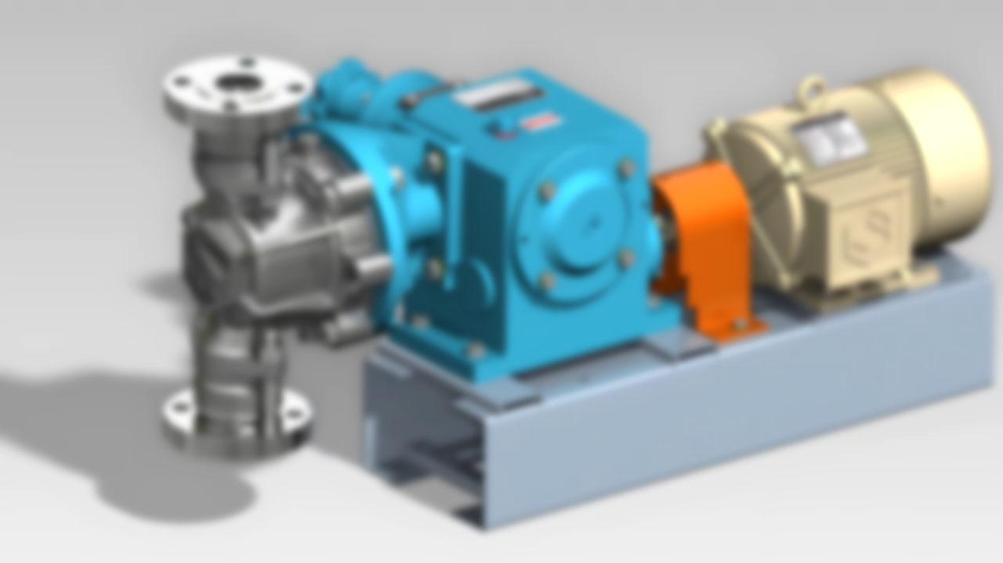

PLUNGER PUMP
Group Members :
Mission Bhattarai (078BCE088)
Nishan KC (078BCE098)
Pramod Chaulagain (078BCE109)
Ronish Sapkota (078BCE128)
Roshan Karki (078BCE129)
Roshan Bhandari (078BCE130)
Presented to :
Ms. Sujata Adhikari
Presenter :
Manoj Sapkota
078BCE087
Manoj Sapkota | Department of Civil Engineering | 078BCE087

Slide 2

Introduction to Pumps
Definition: A hydraulic machine that converts Mechanical Energy (from a motor) into Hydraulic Energy (Pressure Energy).
Primary Functions:
Transfer liquid from a low-pressure zone to a high-pressure zone.
Lift liquid from a lower level to a higher level.
Circulate liquid against system resistance.

Slide 3
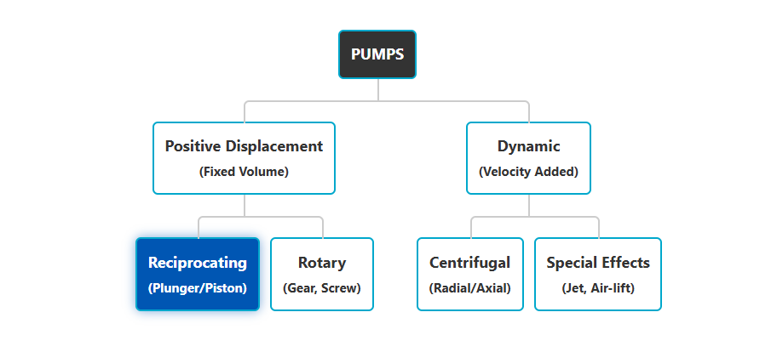
Classification of Pumps
Pumps are broadly classified based on how they transfer energy to the fluid.

Slide 4
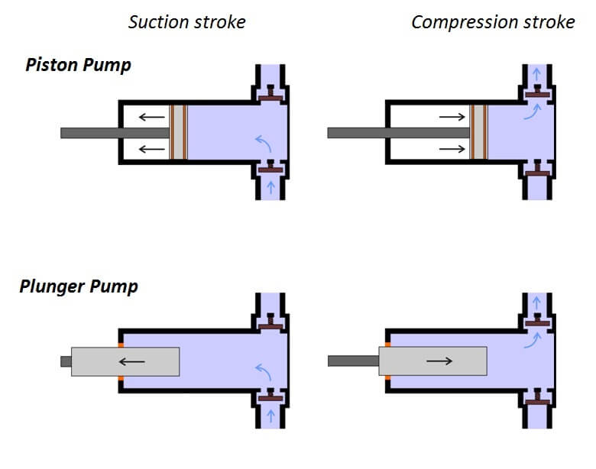
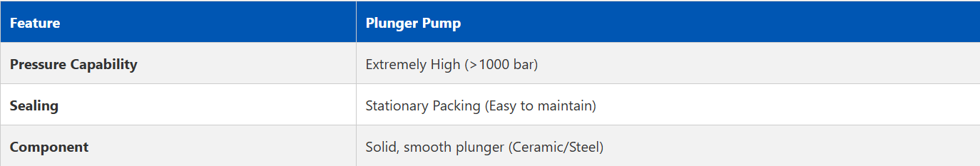
Plunger Pump vs. Piston Pump
While both are reciprocating pumps, the key difference lies in the sealing mechanism.
Source : https://hosturl.link/GSvspq

Slide 5
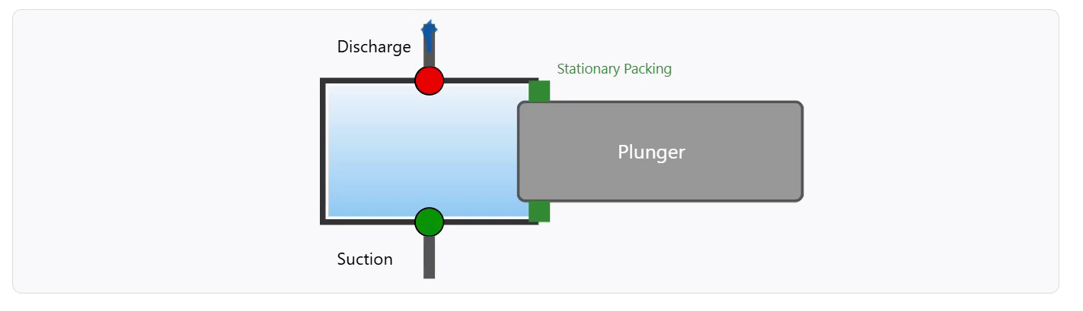
Working Principle
The operation consists of two strokes: Suction and Discharge.
Suction Stroke (Plunger moves Right): Vacuum created. Inlet valve opens (Green). Outlet valve closes (Red). Fluid enters.
Discharge Stroke (Plunger moves Left): Volume decreases. Pressure rises. Inlet valve closes. Outlet valve opens. Fluid forced out.

Slide 6
Construction Features
1. The Plunger
Unlike a piston, the plunger is a solid cylinder. It is often made of Ceramic or high-grade Stainless Steel to resist wear and corrosion.
2. Stationary Packing
The seal does not move. This allows for tighter sealing arrangements, enabling the pump to reach pressures up to 20,000 PSI.
3. Valves
Spring-loaded check valves (ball or poppet type) ensure uni-directional flow.
4. Drive Mechanism
Powered by an electric motor or diesel engine connected via a crankshaft to convert rotary motion to reciprocating motion.

Slide 7
Suitability: When to use it?
High Pressure, Low Flow
Ideal for applications needing massive pressure where volume is secondary.
Viscous Fluids
Handles heavy oils, sludge, and slurries better than centrifugal pumps.
Metering / Dosing
Exact volume per stroke makes it perfect for chemical dosing (e.g., fertilizer injection).
Self-Priming
Can pump air/gas to clear lines, unlike standard centrifugal pumps.

Slide 8
Real-World Applications
High-Pressure Washing: Car washes and industrial surface cleaning (The most common use).
Reverse Osmosis (RO): Pushing salt water through membranes in desalination.
Oil & Gas: Injecting methanol or glycol into wells at high pressure.
Water Jet Cutting: Using water to cut steel/stone.

Slide 9
Advantages vs. Disadvantages
Advantages
Capable of very high discharge pressures.
High hydraulic efficiency.
Constant flow rate (Positive Displacement).
Self-priming capability.
Disadvantages
Pulsating Flow: Requires dampeners.
Maintenance: Valves and packing need monitoring.
Size/Weight: Heavy and bulky.
Higher initial cost than centrifugal pumps.

Slide 10
Conclusion:
"The Plunger Pump is the Powerhouse of Pressure. It sacrifices smooth flow for raw force and precision."

Slide 11
References
Bansal, R. K. (2005). A textbook of fluid mechanics and hydraulic machines. Laxmi Publications.
Grundfos. (2023). The pump handbook. Grundfos Management A/S.
Modi, P. N., & Seth, S. M. (2002). Hydraulics and fluid mechanics including hydraulics machines. Standard Book House.
Pump School. (n.d.). Plunger vs piston pumps.
White, F. M. (2011). Fluid mechanics (7th ed.). McGraw-Hill Education.

